Slide 1

Software Process Structure

Slide 2
Chapter 3
Software Process Structure
Slide Set to accompany
Software Engineering: A Practitioner’s Approach, 8/e
by Roger S. Pressman and Bruce R. Maxim
Slides copyright © 1996, 2001, 2005, 2009, 2014 by Roger S. Pressman
For non-profit educational use only
May be reproduced ONLY for student use at the university level when used in conjunction with Software Engineering: A Practitioner's Approach, 8/e. Any other reproduction or use is prohibited without the express written permission of the author.
All copyright information MUST appear if these slides are posted on a website for student use.
These slides are designed to accompany Software Engineering: A Practitioner’s Approach, 8/e
(McGraw-Hill, 2014). Slides copyright 2014 by Roger Pressman.

Slide 3
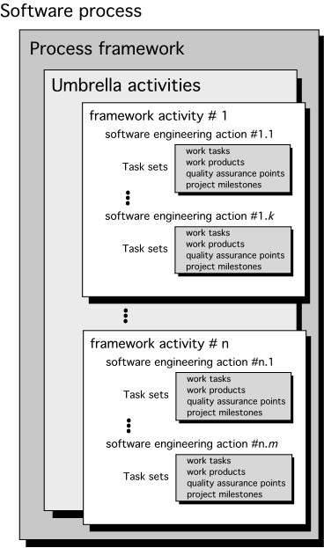
A Generic Process Model
These slides are designed to accompany Software Engineering: A Practitioner’s Approach, 8/e
(McGraw-Hill, 2014). Slides copyright 2014 by Roger Pressman.

Slide 4
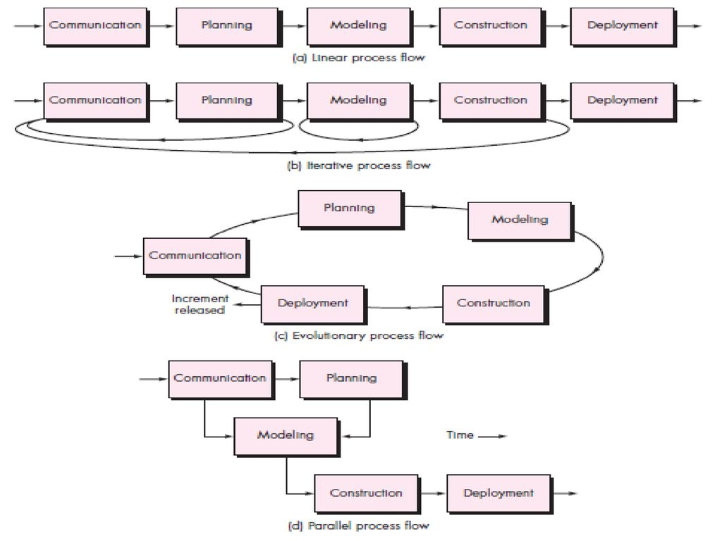
Process Flow
These slides are designed to accompany Software Engineering: A Practitioner’s Approach, 8/e
(McGraw-Hill, 2014). Slides copyright 2014 by Roger Pressman.

Slide 5
Identifying a Task Set
A task set defines the actual work to be done to accomplish the objectives of a software engineering action.
A list of the task to be accomplished
A list of the work products to be produced
A list of the quality assurance filters to be applied
These slides are designed to accompany Software Engineering: A Practitioner’s Approach, 8/e
(McGraw-Hill, 2014). Slides copyright 2014 by Roger Pressman.

Slide 6
Process Patterns
A process pattern
describes a process-related problem that is encountered during software engineering work,
identifies the environment in which the problem has been encountered, and
suggests one or more proven solutions to the problem.
■
Stated in more general terms, a process pattern provides you with a template [Amb98]—a consistent method for describing problem solutions within the context of the software process.
These slides are designed to accompany Software Engineering: A Practitioner’s Approach, 8/e
(McGraw-Hill, 2014). Slides copyright 2014 by Roger Pressman.

Slide 7
Process Pattern Types
Task patterns—defines a problem associated with a software engineering action or work task and relevant to successful software engineering practice
Stage patterns—defines a problem associated with a framework activity for the process.
Phase patterns—define the sequence of framework activities that occur with the process, even when the overall flow of activities is iterative in nature.
These slides are designed to accompany Software Engineering: A Practitioner’s Approach, 8/e
(McGraw-Hill, 2014). Slides copyright 2014 by Roger Pressman.

Slide 8
Process Assessment and Improvement
Standard CMMI Assessment Method for Process Improvement (SCAMPI) — provides a five step process assessment model that incorporates five phases: initiating, diagnosing, establishing, acting and learning.
CMM-Based Appraisal for Internal Process Improvement (CBA IPI)—provides a diagnostic technique for assessing the relative maturity of a software organization; uses the SEI CMM as the basis for the assessment [Dun01]
SPICE—The SPICE (ISO/IEC15504) standard defines a set of requirements for software process assessment. The intent of the standard is to assist organizations in developing an objective evaluation of the efficacy of any defined software process. [ISO08]
ISO 9001:2000 for Software—a generic standard that applies to any organization that wants to improve the overall quality of the products, systems, or services that it provides. Therefore, the standard is directly applicable to software organizations and companies. [Ant06]
These slides are designed to accompany Software Engineering: A Practitioner’s Approach, 8/e
(McGraw-Hill, 2014). Slides copyright 2014 by Roger Pressman.

Slide 9
Process Models

Slide 10
Chapter 4
Process Models
Slide Set to accompany
Software Engineering: A Practitioner’s Approach, 8/e
by Roger S. Pressman and Bruce R. Maxim
Slides copyright © 1996, 2001, 2005, 2009, 2014 by Roger S. Pressman
For non-profit educational use only
May be reproduced ONLY for student use at the university level when used in conjunction with Software Engineering: A Practitioner's Approach, 8/e. Any other reproduction or use is prohibited without the express written permission of the author.
All copyright information MUST appear if these slides are posted on a website for student use.
These slides are designed to accompany Software Engineering: A Practitioner’s Approach, 8/e
(McGraw-Hill, 2014). Slides copyright 2014 by Roger Pressman.

Slide 11
The Software Process
A structured set of activities required to develop a
software system.
Many different software processes but all involve:
  Specification – defining what the system should do;
  Design and implementation – defining the organization of the system and implementing the system;
  Validation – checking that it does what the customer wants;
  Evolution – changing the system in response to changing customer needs.
A software process model is an abstract representation of a process. It presents a description of a process from some particular perspective.

Slide 12
Software Process Descriptions
When we describe and discuss processes, we usually talk about the activities in these processes such as specifying a data model, designing a user interface, etc. and the ordering of these activities.
Process descriptions may also include:
  Products, which are the outcomes of a process activity;
  Roles, which reflect the responsibilities of the people involved in the process;
  Pre- and post-conditions, which are statements that are true before and after a process activity has been enacted or a product produced.

Slide 13
Plan-driven and Agile Processes a.k.a. Heavy-Weight versus Light-Weight Models
Plan-driven processes are processes where all of the process activities are planned in advance and progress is measured against this plan.
  Plan drives everything!
In Agile, process planning is incremental and it is easier to change the process to reflect changing customer requirements.
In practice, most practical processes include elements of both plan-driven and agile.
There are no right or wrong software processes.

Slide 14
Prescriptive Models
Prescriptive process models advocate an orderly approach to software engineering
That leads to a few questions …
■
If prescriptive process models strive for structure and order, are they inappropriate for a software world that thrives on change?
Yet, if we reject traditional process models (and the order they imply) and replace them with something less structured, do we make it impossible to achieve coordination and coherence in software work?
These slides are designed to accompany Software Engineering: A Practitioner’s Approach, 8/e
(McGraw-Hill, 2014). Slides copyright 2014 by Roger Pressman.

Slide 15
The Waterfall Model
Communication
project initiation
Planning
estimating scheduling tracking
requirement gathering
Modeling
analysis design
Construction
Deployment
delivery support
feedback
code test
These slides are designed to accompany Software Engineering: A Practitioner’s Approach, 8/e
(McGraw-Hill, 2014). Slides copyright 2014 by Roger Pressman.

Slide 16
Software Process Models - heavyweight model
  Plan-driven model.
  Separate and distinct phases of specification and development.
  Heavily oriented toward documentation (documentation-intensive)
  Progress is often measured thru documentation completion and reviews (many)
  Gantt charts
  Lockstep approach
  Little chance for Change!
  Oftentimes discover major flaws too late.
  Delivered as Big Bang
  Still exists in spades – but modified to a degree.

Slide 17
Limitations
The main drawback of the waterfall model is the difficulty of accommodating change after the process is underway. In principle, a phase has to be completed before moving on to the next phase.
But many issues are true too, such as risk addressing.
Inflexible partitioning of the project into distinct stages makes it difficult to respond to changing customer requirements.
  Therefore, this model is only appropriate when the requirements are well-understood and changes will be fairly limited during the design process.
  Few business systems have stable requirements.

Slide 18

The Incremental Model
increment #n
C o m m u n i c a
t i o n
P l a n n i n g
M o d e l i n g
analys is
des ign
C o n s t r u c t i
code t est
o n
D e p l o y m e n d e l i v e r y f e e d b a c k
t
delivery of
nth increment
increment #2
C o m m u n i c a
t i o n
P l a n n i n g
M o d e l i n g
analysis
design
C o n s t r u c t i
code t est
o n
D e p l o y m e n t d e l i v e r y
f e e d b a c k
increment #1
delivery of 2nd increment
C o m m u n i c a t i o n
P l a n n i n g
M o d e l i n g analysis design
C o n s t r u c t i o n
code t es t
D e p l o y m e n t
delivery of 1st increment
d e l i v e r y f e e d b a c k
project calendar time
These slides are designed to accompany Software Engineering: A Practitioner’s Approach, 8/e
(McGraw-Hill, 2014). Slides copyright 2014 by Roger Pressman.

Slide 19
The Incremental Model (Contd.)
Requirements are divided into multiple standalone modules of the software development cycle.
In this model, each module goes through the requirements, design, implementation, and testing phases. Every subsequent release of the module adds a function to the previous release.
Continues until the complete system is achieved.

Slide 20
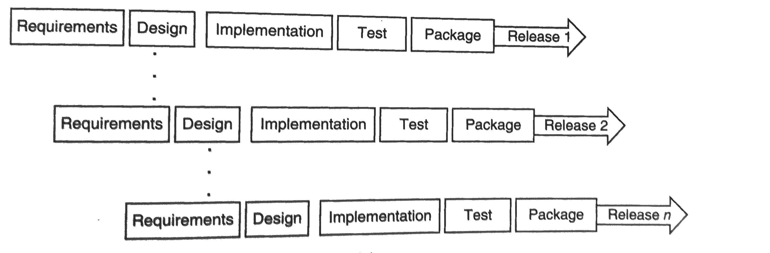
The Incremental Model (Contd.)
Alternatively, first develop the core of the system with the required functionality.
Deliver this as Release 1.
Later do other releases.
This is more like evolutionary development.

Slide 21
The Incremental Model (Contd.)
Modification of waterfall
Divide project into components and develop each component separately.
Initially the Waterfall model was used for developing each component.
Pro | Con.
-It has lowers initial delivery cost. -It has incremental resource deployment. -It can deduct errors easily because core modules are used by the customer from the beginning of the phase . -These are tested thoroughly. | Needs a clear and complete definition of the whole system before it can be broken down and built incrementally. Total cost is higher than waterfall.

Slide 22
Evolutionary Models: Prototyping
Qu_{Q}ick_{ui}p_{c}l_{k}an
plan
Communication
communication
M_{M}od_{o}e_{d}li_{e}n_{l}g_{ing}
Quick design
Quick design
Deployment
Construction
D_{D}e_{e}p_{l}l_{i}o_{v}y_{e}m_{ry}ent
delivery_{b}& feedback
o
f prototype
Construction
Construction ofrprototype
These slides are designed to accompany Software Engineering: A Practitioner’s Approach, 8/e
(McGraw-Hill, 2014). Slides copyright 2014 by Roger Pressman.

Slide 23
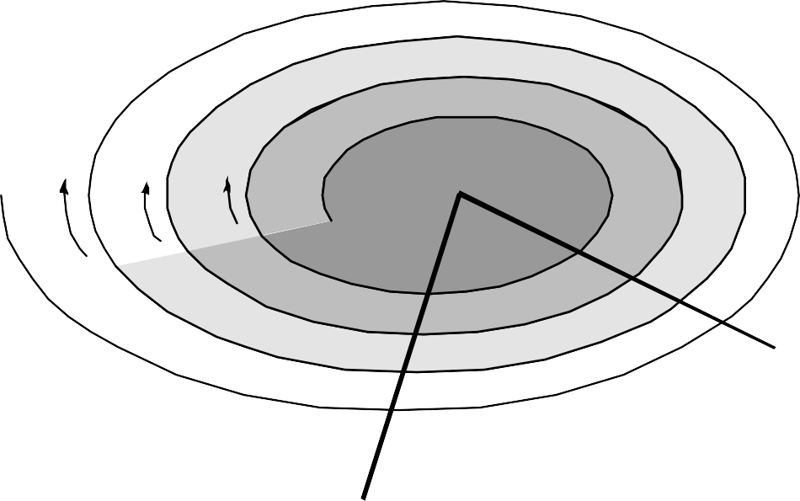
Evolutionary Models: The Spiral
planning estimation scheduling risk analysis
communication
modelin analysis design
start
deployment delivery feedback
construction
code
test
These slides are designed to accompany Software Engineering: A Practitioner’s Approach, 8/e
(McGraw-Hill, 2014). Slides copyright 2014 by Roger Pressman.

Slide 24
The Spiral Model
Process is represented as a spiral rather than as a sequence of activities with backtracking.
No fixed phases such as specification or design - loops in the spiral are chosen depending on what is required.
Risks are explicitly assessed and resolved throughout the process.
  This was the motivation behind developing the Spiral Model - Risk

Slide 25
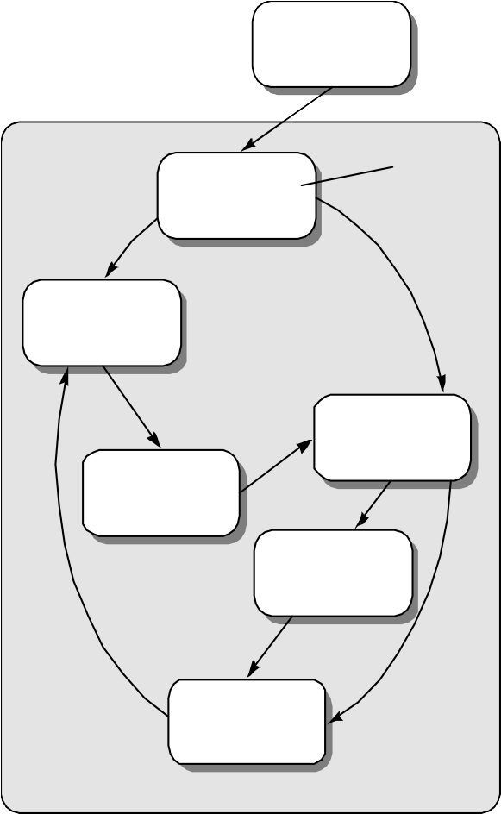
Evolutionary Models: Concurrent
none
Modeling activity
Under development
represents the state
of a software engineering activity or task
Awaiting changes
Under review
Under revision
Baselined
Done
These slides are designed to accompany Software Engineering: A Practitioner’s Approach, 8/e
(McGraw-Hill, 2014). Slides copyright 2014 by Roger Pressman.

Slide 26
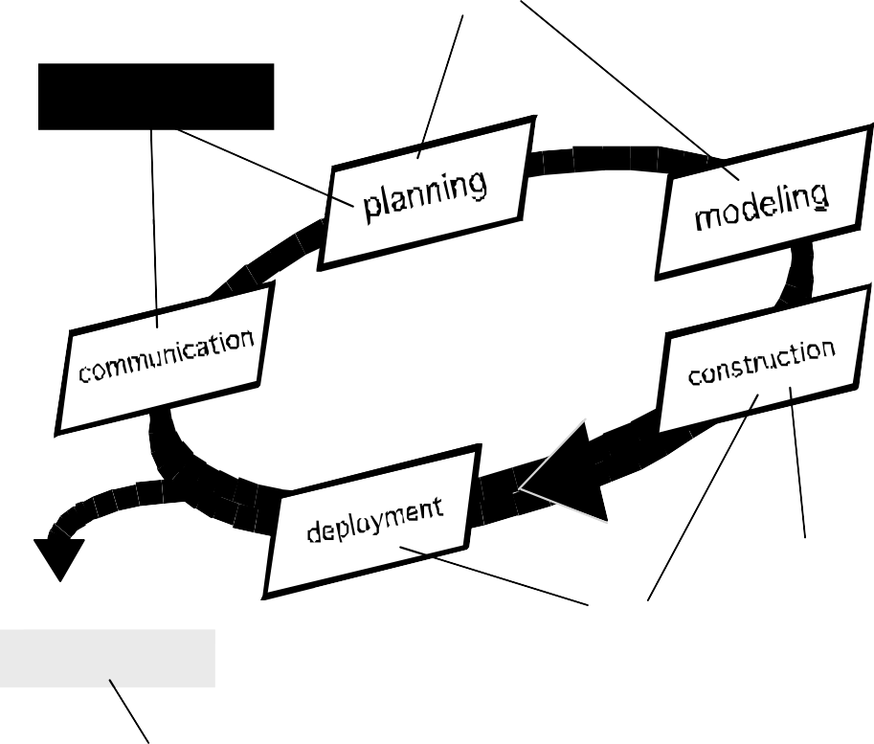
The Rational Unified Process (UP)
elaboration
inception
construction
transition
Release
software increment
production
These slides are designed to accompany Software Engineering: A Practitioner’s Approach, 8/e
(McGraw-Hill, 2014). Slides copyright 2014 by Roger Pressman.

Slide 27

RUP Phases
UP Phases
Inception
Elaboration
Construction
Transition
Production
Workflows
Requirements
Analysis Design
Implementation
Test Support
Iterations
#1 #2
#n-1 #n
These slides are designed to accompany Software Engineering: A Practitioner’s Approach, 8/e
(McGraw-Hill, 2014). Slides copyright 2014 by Roger Pressman.

Slide 28
RUP Work Products
Inception phase
Elaboration phase
Use-case model
Supplementary requirements
including non-functional
Analysis model
Software architecture
Description.
Executable architectural prototype.
Preliminary design model Revised risk list
Project plan including
iteration plan
adapted workflows milestones
technical work products Preliminary user manual
Vision document
Initial use-case model Initial project glossary
Init al business case
Initial risk assessment. Project plan,
phases and iterations.
Business model, if necessary.
One or more prototypes
Construction phase
Design
model Soft are components
Integrated software increment
Test plan and procedure Test cases
Support document at ion
user manuals installation manuals description of current
Increment
Transition phase
Delivered software increment Bet at least reports
General user feedback
These slides are designed to accompany Software Engineering: A Practitioner’s Approach, 8/e
(McGraw-Hill, 2014). Slides copyright 2014 by Roger Pressman.

Slide 29
Rational Unified Process
An agile software development methodology.
Splits the project life cycle into four phases.
During each of the phases, all six core development disciplines take place: business modeling, requirements, analysis and design, implementation, testing, and deployment.
However, certain processes are more important and take up more time during every stage.

Slide 30

The V-Model
These slides are designed to accompany Software Engineering: A Practitioner’s Approach, 8/e
(McGraw-Hill, 2014). Slides copyright 2014 by Roger Pressman.

Slide 31
Still Other Process Models
Component based development—the process to apply when reuse is a development objective
Formal methods—emphasizes the mathematical specification of requirements
AOSD—provides a process and methodological approach for defining, specifying, designing, and constructing aspects
Unified Process—a “use-case driven, architecture-centric, iterative and incremental” software process closely aligned with the Unified Modeling Language (UML)
These slides are designed to accompany Software Engineering: A Practitioner’s Approach, 8/e
(McGraw-Hill, 2014). Slides copyright 2014 by Roger Pressman.

Slide 32
New and Emerging Process Methodologies

Slide 33
What are Agile Processes?
Agile processes are family of software development methodologies that produce software in short iterations and allow for greater changes in design.
Software development is still very labor intensive, the Agile methodologies also focus on human and team aspect of software development.

Slide 34
Characteristics of Agile
Short releases and iteration: Divide the work into small pieces. Release the work as often as possible
Incremental design: Don’t try to complete the design up front because not enough is known early about the system anyway.
User involvement: Rather than trying to produce formal, complete, and immutable standard at the beginning, ask user involved with the project to provide constant feedback.
Minimal documentation: Do necessary amount of documentation.
Informal communication: Maintain constant communication, but not necessarily through formal documentation.
Change: Assume that the requirements and environment will change.

Slide 35
Why Agile Process?
Lengthy development times
Inability to cope with changing requirements
Assumption that requirements are completely understood before the project begins
Too much reliance on heroic developer efforts: Unless the team is extremely motivated, group members cannot sustain these efforts for too long.
Complex methodology: Most traditional methodologies provide details specification of activities and work product. Such specification can be daunting.
Waste/ duplication of efforts: Changes to code may also imply change to UML diagrams.

Slide 36

Agility and the Cost of Change
These slides are designed to accompany Software Engineering: A Practitioner’s Approach, 8/e
(McGraw-Hill, 2014) Slides copyright 2014 by Roger Pressman.

Slide 37
An Agile Process
Is driven by customer descriptions of what is required (scenarios)
Recognizes that plans are short-lived
Develops software iteratively with a heavy emphasis on construction activities
Delivers multiple ‘software increments’ Adapts as changes occur
These slides are designed to accompany Software Engineering: A Practitioner’s Approach, 8/e
(McGraw-Hill, 2014) Slides copyright 2014 by Roger Pressman.

Slide 38
Agility Principles - I
Our highest priority is to satisfy the customer through early and continuous delivery of valuable software.
Welcome changing requirements, even late in development. Agile processes harness change for the customer's competitive advantage.
Deliver working software frequently, from a couple of weeks to a couple of months, with a preference to the shorter timescale.
Business people and developers must work together daily throughout the project.
Build projects around motivated individuals. Give them the environment and support they need, and trust them to get the job done.
The most efficient and effective method of conveying information to and within a development team is face–to–face conversation.
These slides are designed to accompany Software Engineering: A Practitioner’s Approach, 8/e
(McGraw-Hill, 2014) Slides copyright 2014 by Roger Pressman.

Slide 39
Agility Principles - II
Working software is the primary measure of progress.
Agile processes promote sustainable development. The sponsors, developers, and users should be able to maintain a constant pace indefinitely.
Continuous attention to technical excellence and good design enhances agility.
Simplicity – the art of maximizing the amount of work not done – is essential.
The best architectures, requirements, and designs emerge from self–organizing teams.
At regular intervals, the team reflects on how to become more effective, then tunes and adjusts its behavior accordingly.
These slides are designed to accompany Software Engineering: A Practitioner’s Approach, 8/e
(McGraw-Hill, 2014) Slides copyright 2014 by Roger Pressman.

Slide 40
Extreme Programming (XP)
XP is one the first and better-know Agile development methodologies.
Using small teams working in the same room to encourage communication.
XP proposes that only the strictly necessary documentation is created, with the code and unit test serving as documentation.
Core values of XP:
  Frequent communication between team members and with customers.
  Simplicity in design and code.
  Feedback at many different levels.
  Courage to implement hard but necessary decisions.

Slide 41
Twelve Key Practices of XP
Planning: Quick determination of features for next release.
Short releases: Try to get a working system quickly
Metaphor: Instead of formal architecture, use metaphor. It is simple and everybody understand it.
Simple design: Try to choose simple solution that works now.
Test-driven development: Ensure that testing is done continuously. Unit testing, TDD, Acceptance testing
Design improvement (refactoring): Remove duplication, improve communication, simplify or add flexibility
Pair programming: Code is always reviewed by a second person.
Collective ownership: Establish ownership of code of whole team.
Continuous integration: Half or full day work integration.
Sustainable pace: work only at pace you can sustain.
On-site customer: Include a real customer on the team.
Coding standards: ask all programmers to follow same set of rules.

Slide 42
More Programmers going “Extreme”
The methodology is gaining more and more devotees. Ford Motor, Chrysler and IBM are among the companies using Extreme Programming in at least some capacity.
John Giblin, senior vice president of engineering at Dublin, Ireland-based software company Iona, turned to Extreme to slash software delivery times.
"Sometimes because of the length of development cycles, by the time the product is developed, the original set of requirements is only partially relevant," Giblin said.
https://www.cnet.com/news/more-programmers-going-extreme/
An interesting research paper:
https://arxiv.org/ftp/arxiv/papers/1409/1409.6599.pdf

Slide 43
Discussion
When to use XP?

Slide 44
When to use XP?
Expect their system’s functionality to change every few months.
Experience constantly changing requirements or work with customers who aren’t sure what they want the system to do.
Want to mitigate project risk, especially around tight deadlines.
Include a small number of programmers (between 2 and 12 is preferable).
Are able to work closely with customers.
Are able to create automated unit and functional tests.
https://www.lucidchart.com/blog/what-is-extreme-programming

Slide 45
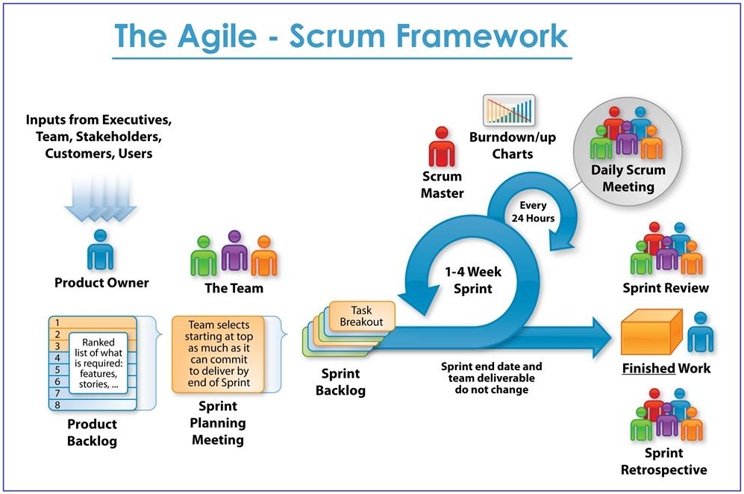
Scrum

Slide 46
SCRUM - Agile Teams
Product Owner: responsible for writing requirements/ user stories.
Scrum Master: Takes care of all processes of agile model.
Scrum Team: Developers and Testers

Slide 47
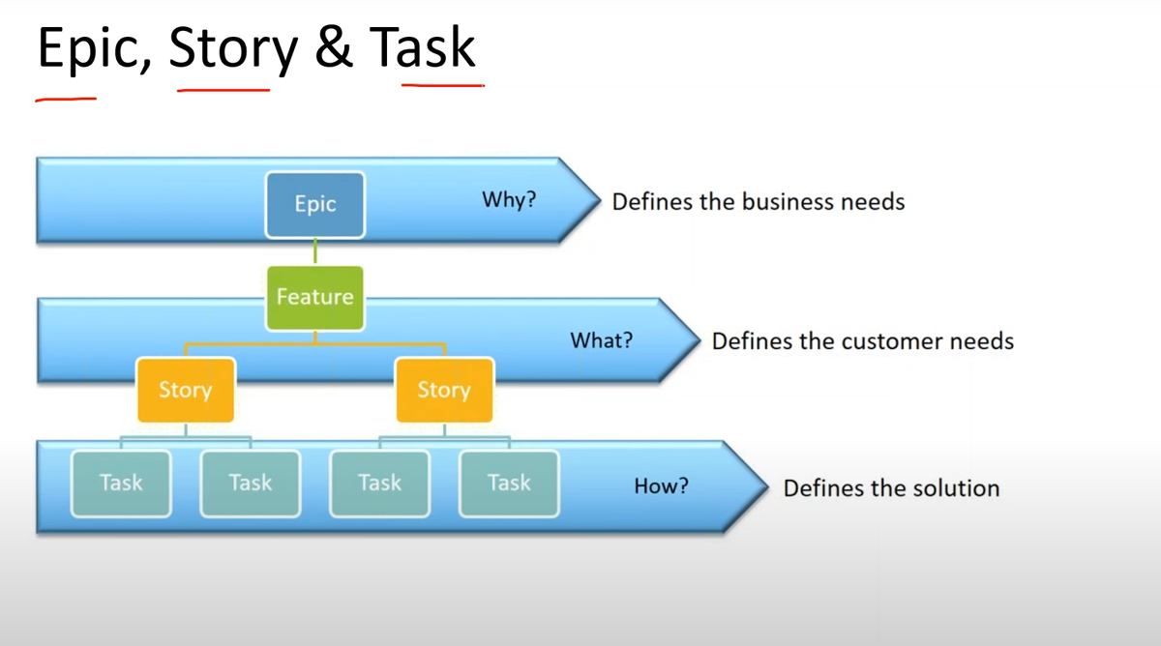

Slide 48
Agile Scrum Activities
How to create project.
How to add users/ people.
How to create Version, Epic, User Stories
Adding user stories to sprint
Starting sprint
Adding subtasks to story
Sprint life cycle
Create bugs

Slide 49
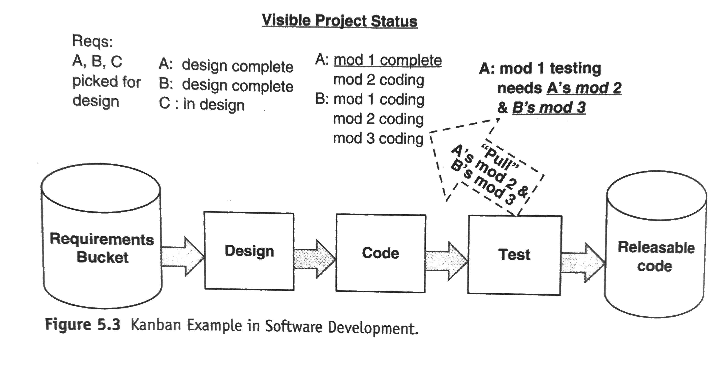
Kanban
Kanban means billboard or visual board in Japanese.
Derived from Toyota Production Systems.

Slide 50
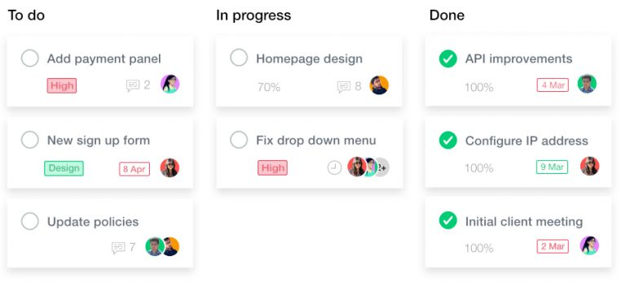
Kanban Boards for Development Team

Slide 51
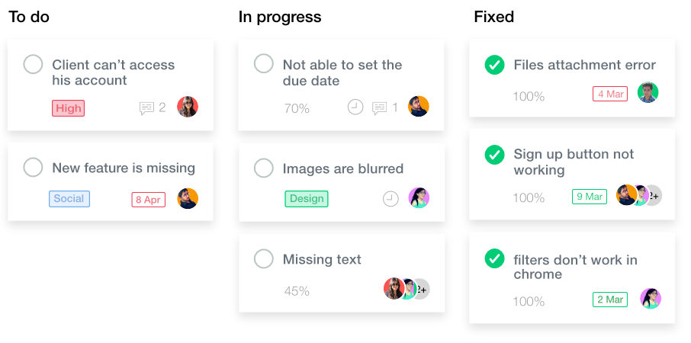
Kanban Boards for Support Team

Slide 52
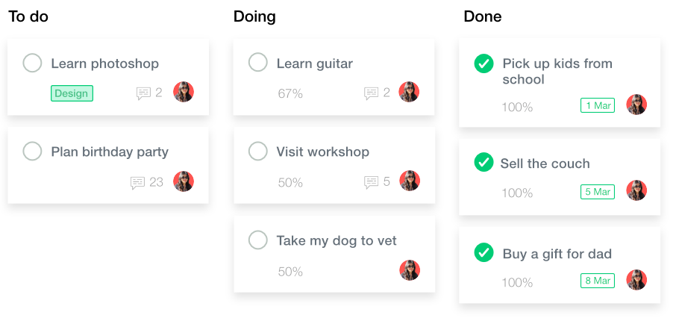
Kanban Board for Personal Use

